Slide 1


Pham Thi Quynh Lam
September 15th, 2025
GITHUB

Slide 2

Outline
Executive Summary
Introduction
Methodology
Results
Conclusion
Appendix

Slide 3
Executive Summary
The purpose of this study is to analyze SpaceX Falcon 9 launch data collected from multiple sources and apply Machine Learning models to predict the success of first-stage landings. The results provide valuable insights for other space agencies when deciding whether to compete with SpaceX.
Methodology:
The research was conducted through the following steps:
Collecting data via API and web scraping
Cleaning and transforming data through data wrangling
Performing exploratory data analysis with SQL and data visualization
Creating interactive maps with Folium to study launch site proximity
Developing dashboards with Plotly Dash for interactive record analysis
Building predictive models to estimate the probability of a successful first-stage landing
Key Outcomes:
This report presents results in several forms:
Data analysis findings
Interactive data visualizations and dashboards
Predictive model outcomes

Slide 4
Introduction
Project background and context
Problems you want to find answers
Private space travel is growing, but high launch costs remain a barrier for new players.
SpaceX’s reusable first-stage technology lowers costs (~62M USD vs. ~165M USD for competitors), giving it a strong advantage.
Can we predict if Falcon 9’s first stage will land successfully?
How do factors (launch site, payload mass, booster version, etc.) influence landing outcomes?
What is the relationship between launch sites and success rates?

Slide 5

Section 1

Slide 6
Methodology
Executive Summary
Data collection methodology:
SpaceX API
Web scraping Falcon 9 & Falcon Heavy launch records from Wikipedia link
Perform data wrangling
Create training labels: 0 = unsuccessful, 1 = successful
Perform exploratory data analysis (EDA) using visualization and SQL
Perform interactive visual analytics using Folium and Plotly Dash
Perform predictive analysis using classification models
Classification models: Logistic Regression, SVM, Decision Tree, KNN
Standardized, split train/test, evaluated model performance

Slide 7
Data Collection
Object: Gather structured and semi-structured data for analysis
Sources: SpaceX API & Wikipedia launch pages
SpaceX API and JSON Data
Web Scraping - An Alternative Data Source
Main API Endpoint: api.spacexdata.com/v4/launches/past
How It Works:
Use the requests library to perform a GET request.
The API response is a list of JSON objects, with each object representing a launch.
Use the .json() method to view the result.
Use the json_normalize() function from Pandas to convert the JSON data into a DataFrame (tabular format).
Other Data Source: Wiki pages related to Falcon 9.
Tool: Use the BeautifulSoup library to extract data from HTML tables.
Purpose: Parse the data from those tables and convert it into a Pandas DataFrame for analysis.

Slide 8
Data Collection – SpaceX API
API Request
Send GET request to SpaceX API
Normalize JSON response and load into a DataFrame
Declare Global Variables
Prepare lists to store data returned by helper functions, e.g., BoosterVersion, PayloadMass, Orbit, LaunchSite, Outcome, Flights, Legs, LandingPad, ReusedCount, Serial, Longitude, Latitude
Call Helper Functions: Extract relevant information using functions like:
getBoosterVersion(data)
getLaunchSite(data)
getPayloadData(data)
getCoreData(data)
Construct Data Dictionary: Combine data from helper functions into a single dictionary
Convert to DataFrame & Filter:
Create DataFrame from dictionary
Filter for Falcon 9 launches
Export to CSV
SpaceX API Workflow
Request launch data via API
Read JSON response → convert to DataFrame
01
02
04
03
Convert DataFrame → CSV for next steps
Extract required fields (preliminary wrangling)

Slide 9
Data Collection - Scraping
Request HTML PageUse HTTP GET to fetch Falcon9 launch page
Parse HTML with BeautifulSoup
Extract Column Names: Find tables and extract header names
Initialize Dictionary: Create launch_dict with extracted column names as keys
Fill Dictionary: Use helper functions to extract table data
Convert to DataFrame
Web Scraping Workflow
Request Falcon launch pages via HTTP GET
Parse HTML with BeautifulSoup
01
02
04
03
Convert DataFrame → CSV for next steps
Extract headers & rows → DataFrame

Slide 10
Data Wrangling
Perform exploratory data analysis and define Training Labels
The dataset contains different cases of booster landings:
Ocean: True = successful, False = unsuccessful
RTLS (ground pad): True = successful, False = unsuccessful
ASDS (drone ship): True = successful, False = unsuccessful
We convert these outcomes into Training Labels:
1 → successful landing
0 → unsuccessful landing
Count launches per site
Count and analyze orbit occurrences
Count mission outcomes per orbit type
Create landing outcome labels from Outcome column
Export cleaned data to CSV

Slide 11
EDA with Data Visualization
We performed Exploratory Data Analysis (EDA) using the following charts to gain deeper insights into the dataset:
Scatter Plot: To examine the relationship and correlation between variables.
Relationship between Flight Number & Launch Site.
Relationship between Payload & Launch Site.
Relationship between Flight Number & Orbit Type.
Relationship between Payload & Orbit Type.
Bar Chart: To compare values and success rates.
Comparison of success rates for each orbit type.
Line Chart: To track and observe trends over time.
Average launch success trend over the years.

Slide 12
EDA with SQL
Using SQL to answer specific data questions.
Launch Sites: We found 4 unique launch sites and analyzed the first 5 launches from CCAFS.
Payload Analysis:
Calculate the total payload for NASA (CRS) missions.
Find the average payload for the F9 v1.1 rocket.
Identify the booster versions that carried the maximum payload.
Landing Outcome Analysis:
Find the date of the first successful ground pad landing.
List booster versions with a payload between 4000-6000 kg that had a successful drone ship landing.
Rank the count of popular landing outcomes by their number

Slide 13
Build an Interactive Map with Folium
Markers were used to plot all launch sites, showing their locations and proximity to coasts.
Colored markers (green for success, red for failure) identified launch sites with higher success rates.
Lines were added to show distances from a launch site to nearby points of interest like railways and highways.

Slide 14
Build a Dashboard with Plotly Dash
Dropdown List: Enables selection of specific launch sites.
Pie Chart: Visualizes total successful launches and the success vs. failure count for a selected site.
Slider: Filters data by payload mass range.
Scatter Chart: Displays the correlation between payload mass and launch success.

Slide 15
Predictive Analysis (Classification)
1
2
3
4
Creating a numpy array from the column “Class” in data
Standardizing the data with StandardScaler, then fitting and transforming it
Splitting the data into training and testing sets with train_test_split function
Create a GridSearchCV object with cv= 10 to find the best parameter
8
7
6
5
Finding the method performs best by examining the Jaccard_score and F1_score metrics
Examining the confusion matrix for all models
Calculating the accuracy on the test data using the method .score() for all models
Applying GridSearchCV on LogReg, SVM, Decision Tree, KNN models

Slide 16

Section 2

Slide 17
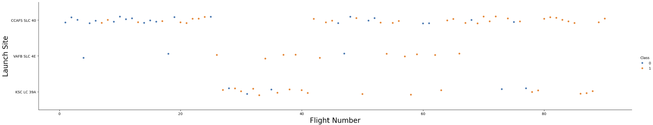
Flight Number vs. Launch Site
Insights:
The earliest flights mostly failed, while the more recent ones all succeeded
CCAFS SLC 40 accounts for about half of all launches.
VAFB SLC 4E and KSC LC 39A show higher success rates.
Overall, the later the flight, the higher the probability of success.

Slide 18
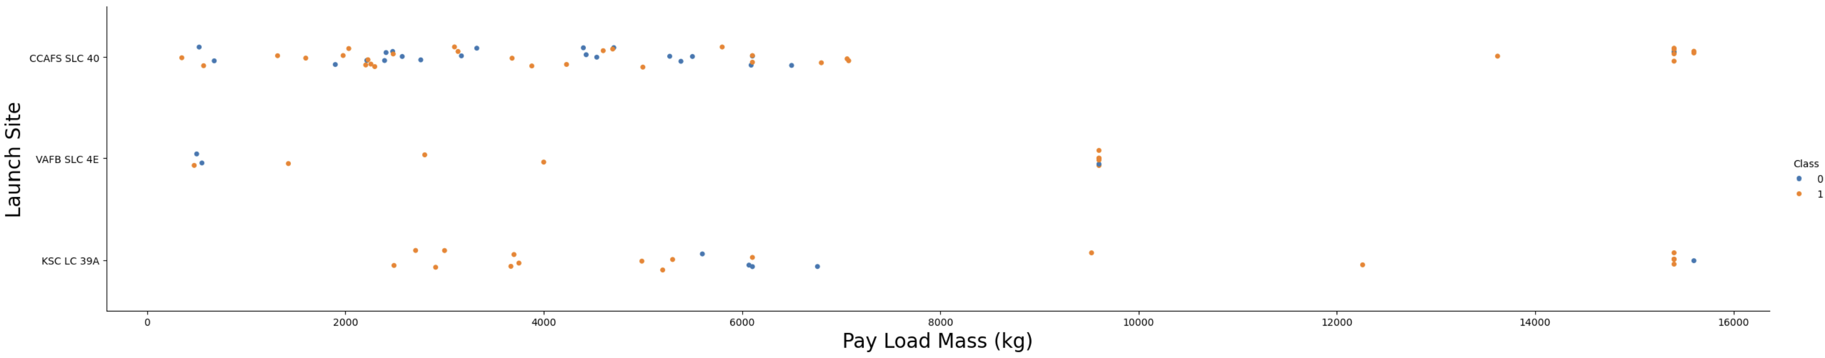
Payload vs. Launch Site
Insights:
At all launch sites, the larger the payload mass, the higher the success rate.
Most launches with payloads over 7000 kg were successful.
KSC LC 39A achieved a 100% success rate for launches with payloads under 5500 kg.

Slide 19
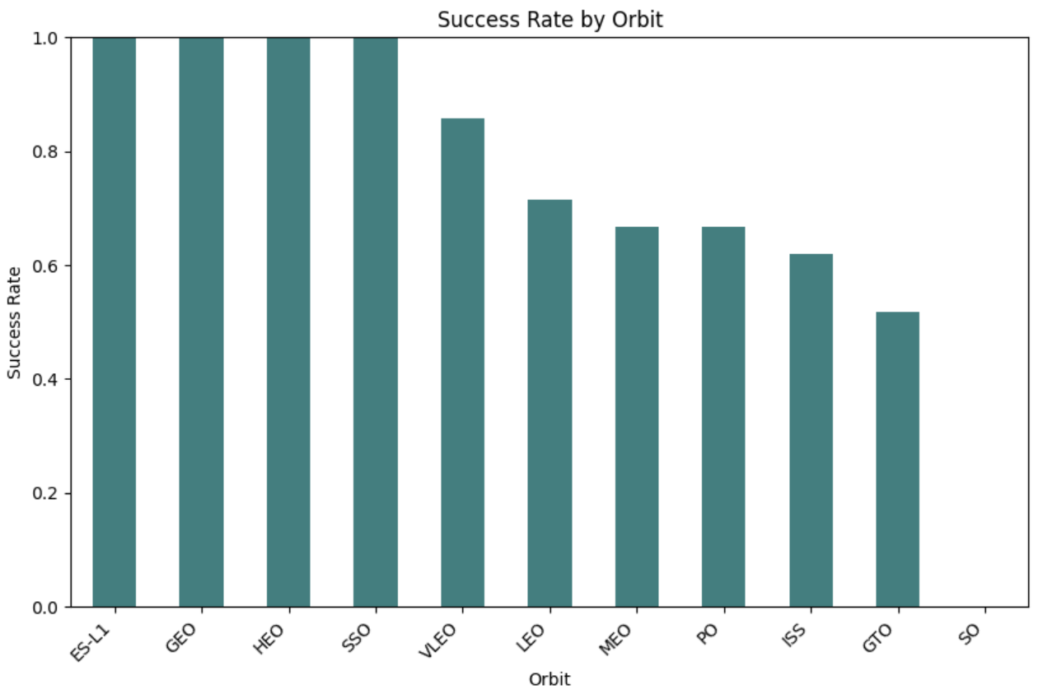
Success Rate vs. Orbit Type
Insights:
100% success rate: ES-L1, GEO, HEO, SSO
0% success rate: SO
Moderate success rate (50%–85%): GTO, ISS, LEO, MEO, PO

Slide 20
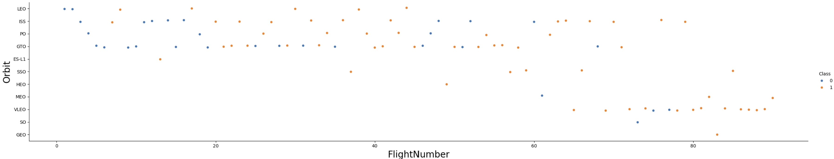
Flight Number vs. Orbit Type
Insights:
For LEO orbits, success rate tends to improve with higher flight numbers.
For GTO orbits, there is no clear relationship between flight number and success rate.

Slide 21
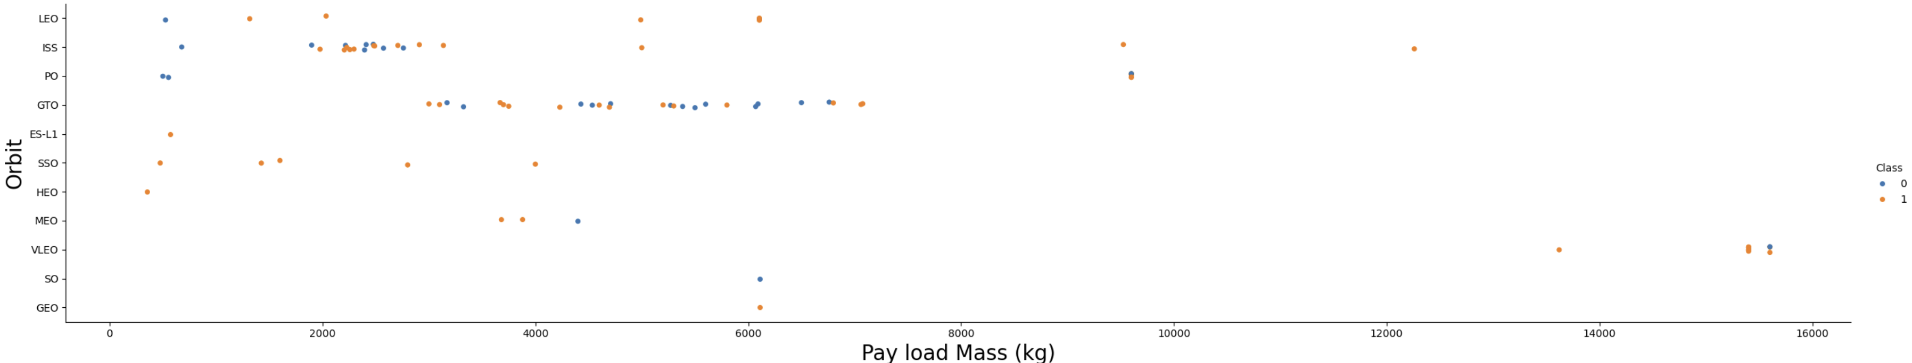
Payload vs. Orbit Type
Insights:
Heavy payloads tend to reduce success rates in GTO orbits.
In contrast, they have a positive effect on Polar LEO (ISS) orbits.
Most successful heavy launches are concentrated in LEO/ISS missions, showing that these orbits are more tolerant of higher payload masses.

Slide 22
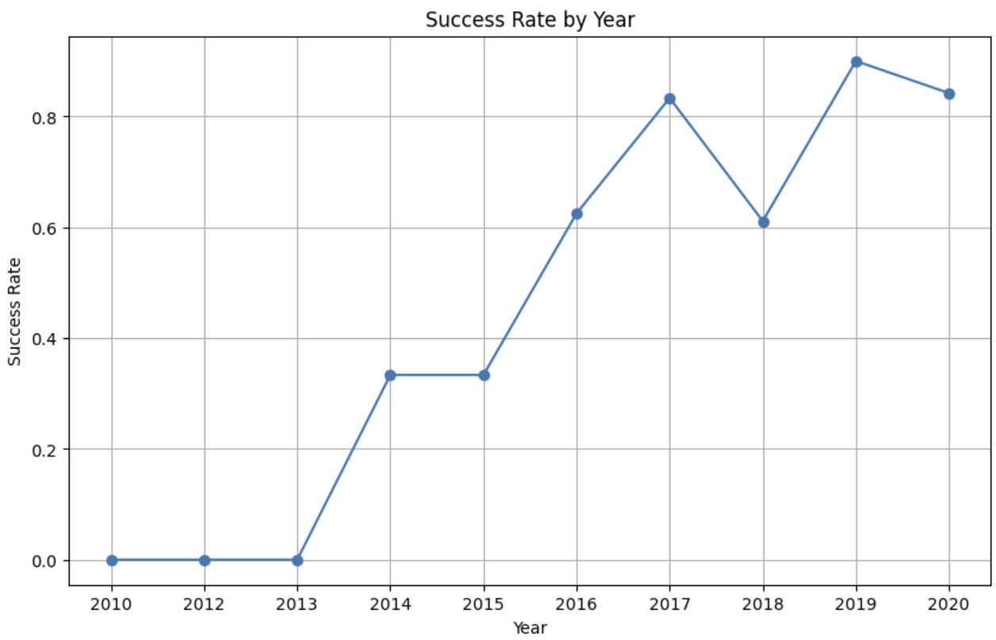
Launch Success Yearly Trend
Insights:
Since 2013, the overall success rate has shown a steady upward trend, peaking close to 90% in 2019.
Although there were slight fluctuations after 2018, the long-term trend indicates continuous improvement in reliability.
This suggests that technological advancements, operational experience, and process optimization have significantly increased mission success over time.

Slide 23

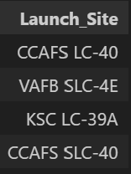
All Launch Site Names
Query:
Explanation:
The keyword DISTINCT ensures only unique values are returned from the Launch_Site column.
There are 4 unique launch sites in the dataset.
Result:

Slide 24
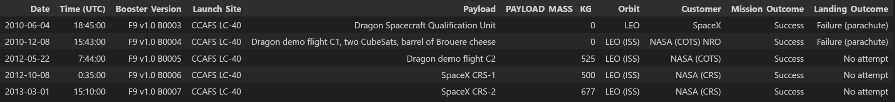
Launch Site Names Begin with 'CCA'
Query:
Explanation:
The keyword LIKE with the pattern 'CCA%' retrieves rows where Launch_Site starts with "CCA".
The LIMIT 5 clause restricts the output to the first 5 matching records.
Result:

Slide 25
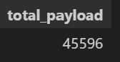
Total Payload Mass
Query:
Explanation:
The SUM function adds up all values in the PAYLOAD_MASS_KG_ column.
This query calculates the total payload mass for missions where the customer is NASA (CRS).
Result:

Slide 26
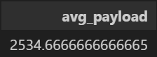
Average Payload Mass by F9 v1.1
Query:
Explanation:
The AVG function computes the average value of the PAYLOAD_MASS_KG_ column.
This query finds the average payload mass for launches using booster version F9 v1.1.
Result:

Slide 27

First Successful Ground Landing Date
Query:
Explanation:
The MIN(Date) function returns the earliest (oldest) date.
The query identifies the first successful ground pad landing.
Result:

Slide 28
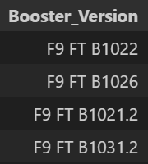
Successful Drone Ship Landing with Payload between 4000 and 6000
Query:
Explanation:
Retrieves booster versions where:
+ Payload mass is between 4000–6000 kg.
+ Landing outcome is successful on a drone ship.
Uses AND to ensure both conditions are met.
Result:

Slide 29
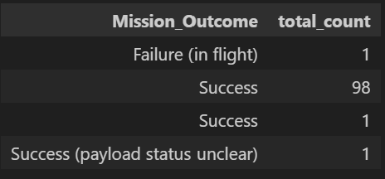
Total Number of Successful and Failure Mission Outcomes
Query:
Explanation:
The GROUP BY keyword groups identical values in the Mission_Outcome column.
The query counts how many times each mission outcome occurred.
Shows the total number of successful and failed missions categorized by outcome type.
Result:

Slide 30
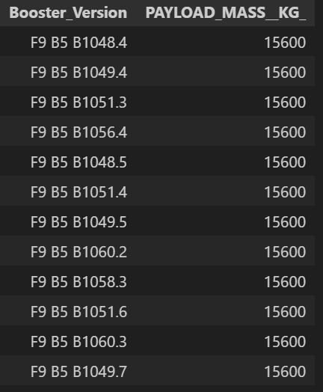
Boosters Carried Maximum Payload
Query:
Explanation:
A subquery finds the maximum payload mass using the MAX function.
The main query retrieves the booster versions along with their payload when it equals the maximum value.
The highest recorded payload mass is 15,600 kg.
Result:

Slide 31
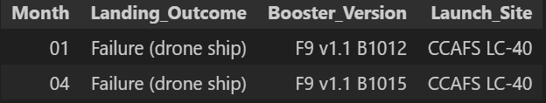
2015 Launch Records
Query:
Explanation:
Lists landing outcome, booster version, and launch site for failed drone ship landings in 2015.
The AND condition ensures both criteria are satisfied:
+ Landing outcome = Failure (drone ship)
+ Year = 2015Shows that CCAFS LC-40 was the launch site with failed landings in 2015.
Booster versions F9 v1.1 B1012 and F9 v1.1 B1015 were unsuccessful.
Result:

Slide 32
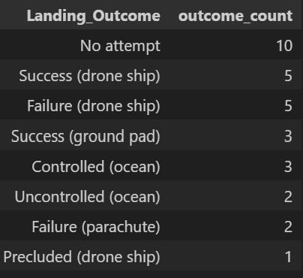
Rank Landing Outcomes Between 2010-06-04 and 2017-03-20
Query:
Explanation:
GROUP BY organizes data by Landing_Outcome.
BETWEEN filters records within the date range (2010-06-04 to 2017-03-20).
ORDER BY DESC sorts the results from highest to lowest count.
The output is a ranked list of landing outcomes for the given period.
Result:

Slide 33

Section 3

Slide 34
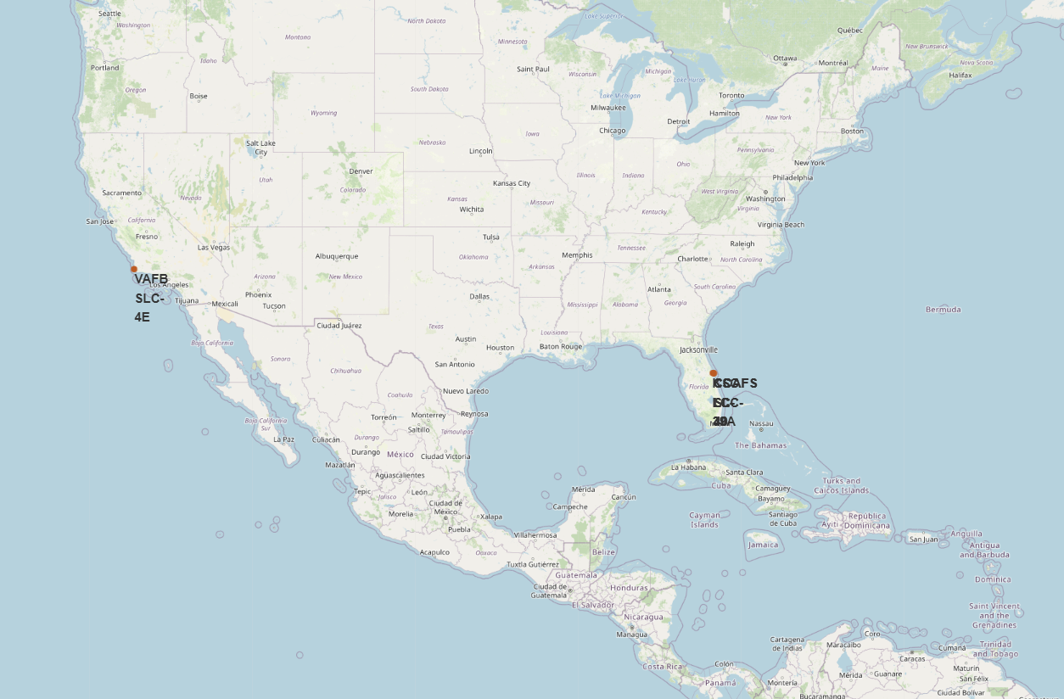
All launch sites’ location markers on a global map
Explanation:
Most launch sites are close to the Equator, where Earth’s surface moves the fastest (~1670 km/h).
→ This extra speed helps rockets reach orbit more efficiently.
Sites are also near coastlines, so rockets launch over the ocean.
→ This reduces risks from falling debris.

Slide 35
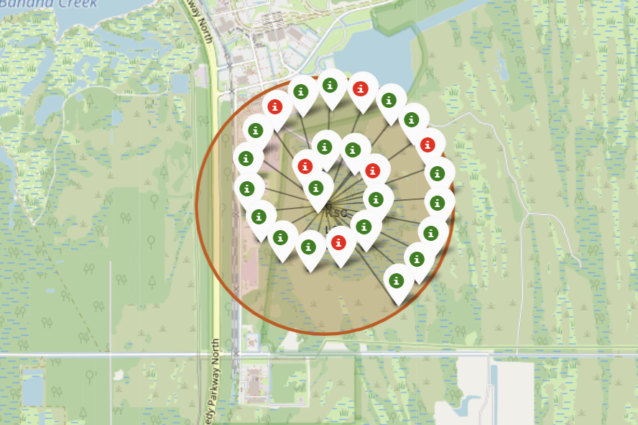
Color-labeled launch records on the map
Explanation:
Markers show launch outcomes by color:
Green = Successful Launch
Red = Failed Launch
Helps quickly identify sites with high success rates.
Example: KSC LC-39A shows a very high success rate

Slide 36
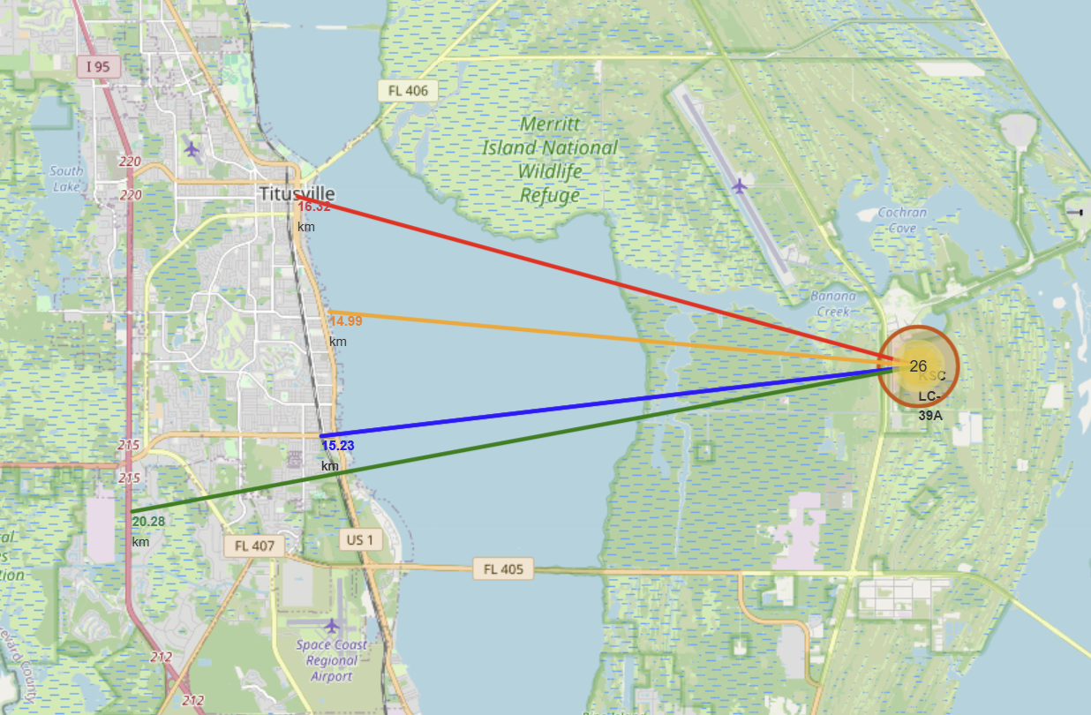
Distance from the launch site KSC LC-39A to its proximities
Explanation:
LC-39A is located relatively close to:
+ Railway (15.23 km)
+ Highway (20.28 km)Coastline (14.99 km)
+ City of Titusville (16.32 km)
A failed rocket, due to its high speed, could cover 15–20 km within seconds, posing potential risks to nearby populated areas.

Slide 37

Section 4

Slide 38
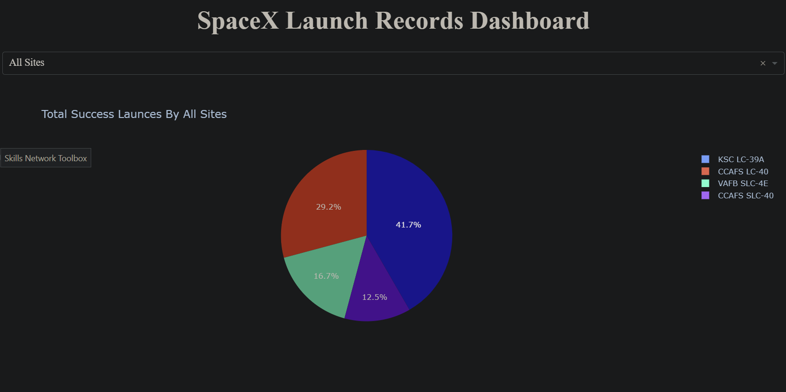
Launch success count for all sites
KSC LC-39A is the primary launch site for SpaceX, with the dominant number of successful launches.

Slide 39
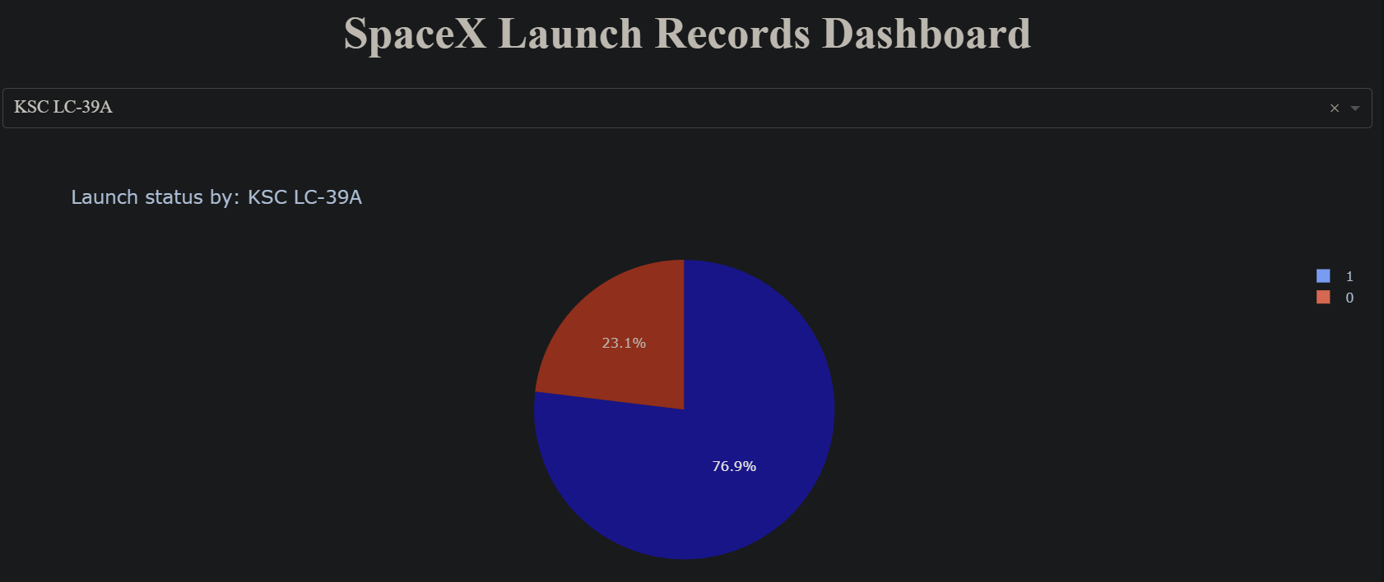
Launch site with highest launch success ratio
At KSC LC-39A, the success rate is 76.9%, while failures account for 23.1%.
This indicates that although LC-39A has a high number of successful launches, a notable risk of failure still exists.

Slide 40
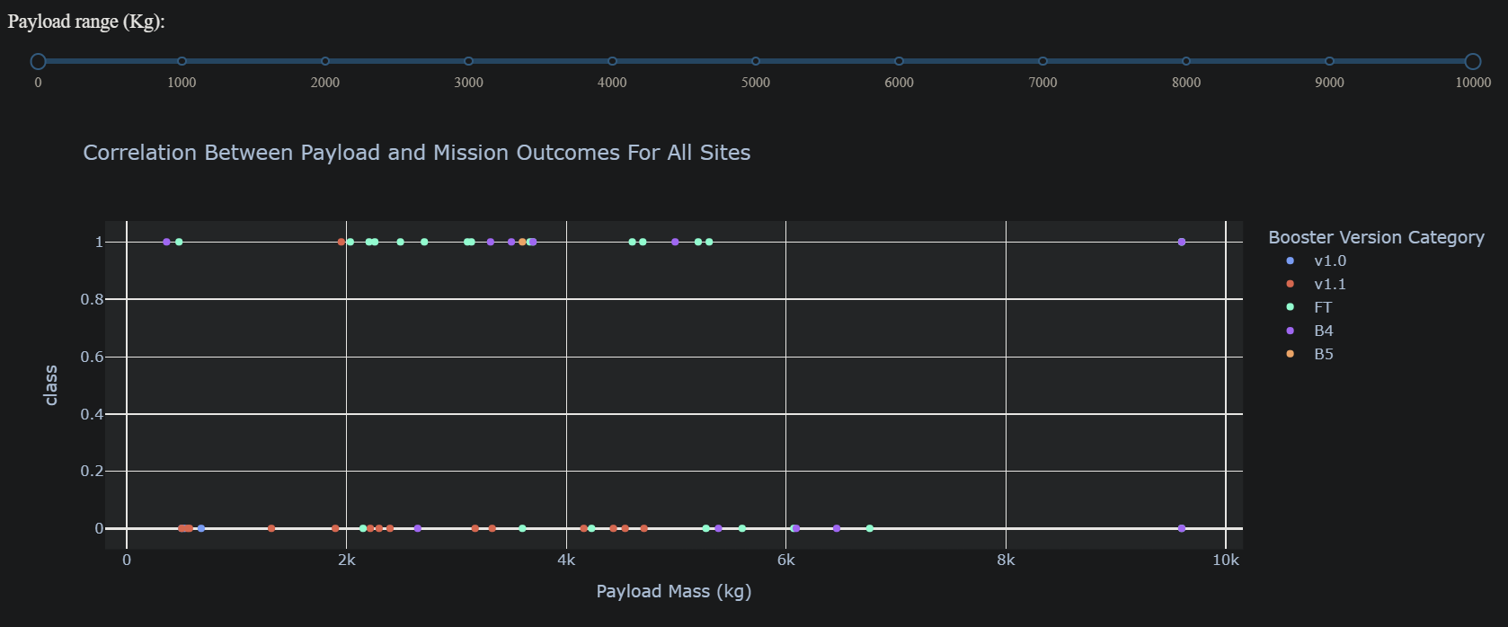
Payload Mass vs Launch Outcome for all sites
v1.0: First generation → high failure rate, especially with low payloads.v1.1: Improved, but still had early failures.FT (Full Thrust): Major leap → high success rates, especially for 2,000–6,000 kg payloads.B4 (Block 4): Stable performance with minimal failures.B5 (Block 5): Latest version → near-perfect success, even with heavy payloads (~10,000 kg).
v1.0: First generation → high failure rate, especially with low payloads.
v1.1: Improved, but still had early failures.
FT (Full Thrust): Major leap → high success rates, especially for 2,000–6,000 kg payloads.
B4 (Block 4): Stable performance with minimal failures.
B5 (Block 5): Latest version → near-perfect success, even with heavy payloads (~10,000 kg).

Slide 41

Section 5

Slide 42
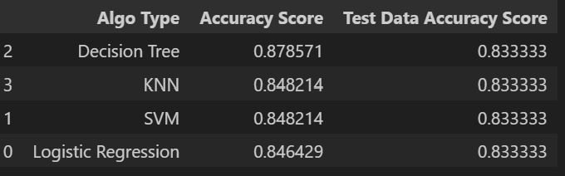
Classification Accuracy
Decision Tree shows the highest training accuracy (0.8786), but on the test set, all models perform equally (0.8333) → indicating no significant advantage on unseen data.
KNN, SVM, and Logistic Regression have very similar training performance (≈0.846–0.848).The gap between train and test accuracy in Decision Tree suggests overfitting.
Overall, all models perform fairly well (>83%). If stability is preferred, SVM or KNN may be the better choice, while Decision Tree may be useful if prioritizing data-specific patterns.

Slide 43
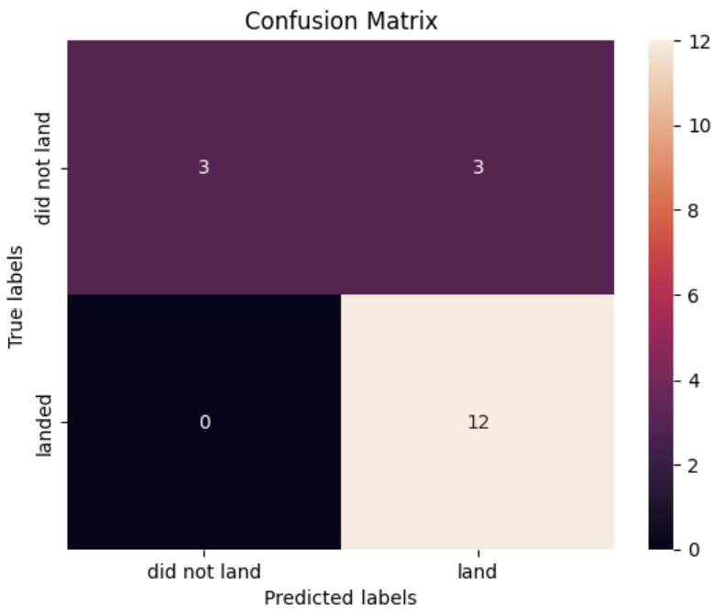
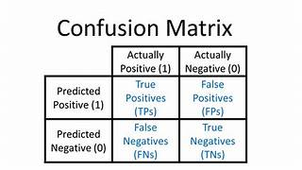
Confusion Matrix
From the confusion matrix, Logistic Regression can distinguish between the two classes: landed and did not land.
Detailed results:
True Positive (TP) = 12: Correctly predicted successful landings.
True Negative (TN) = 3: Correctly predicted actually did not land → this is the major failed landings.
False Positive (FP) = 3: Predicted "landed" while the rocket issue.
False Negative (FN) = 0: No missed successful landings.
Overall, the model performs quite well (high TP, zero FN), but False Positives remain the key weakness.
In a real-world SpaceX scenario, False Positives are particularly risky because they may incorrectly assume a booster is safe for reuse when it actually failed.

Slide 44
Conclusions
The Decision Tree model provides the best performance for this dataset.
Launches with lighter payloads tend to achieve higher success rates compared to heavier payloads.
Most launch sites are located close to the Equator and the coastline, which contributes to higher efficiency.
The success rate of launches has steadily improved over the years.
KSC LC-39A stands out as the launch site with the highest success rate.
Missions to orbits ES-L1, GEO, HEO, and SSO have achieved a 100% success rate.

Slide 45


